Slide 1
Applied Data Science Capstone The Battle of Neighborhoods
A.BHARATHKUMAR
a.bharath98@gmail.com

Slide 2
IDEALOGY
The main idea of this project is to find the similar neighborhood between two cities based on the venues over there because a person will fell more comfortable if he finds the same ambience while he moved from one city to another city which may wont affect his lifestyle

Slide 3
Objective
By using K-Means algotithm and cosine similarity we are going to find the similar neighborhood for a person in two different cities

Slide 4
Work flow
1.Gathering data for both cities (JSON or CSV file )
2.using foursquare API getting the info about venues and their longitude and latitude
3.getting their unique venues between two cities
4.apply PCA for dimensionality reduction
5.Fit k-means to cluster the neighborhood
6.visualize it for better understanding
7.validate it

Slide 5

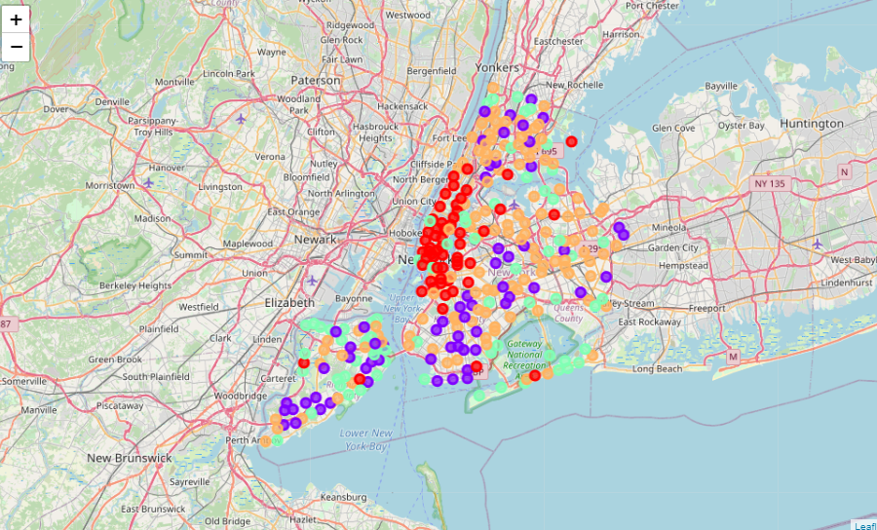
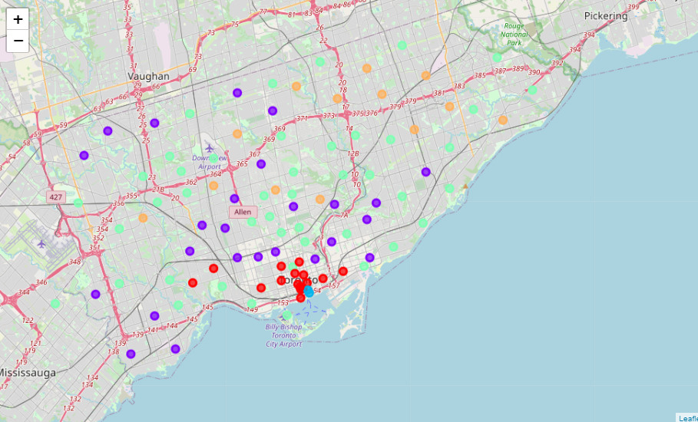
Result
The above pic shows the clustered pins in Toronto city and below pic shows the clustered pins in new York city so by comparing this both pic one can easily find the similar neighborhood between this cities

Slide 6
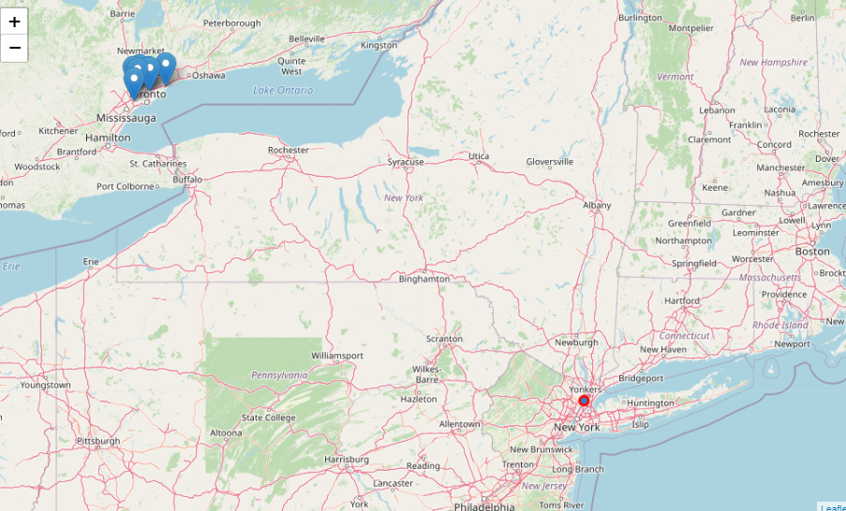
Reult
Here one decides to move from Bronx, Riverdale, New York so in the map it pinned the neighborhood in Toronto which almost has similar venues like Bronx,Newyork

Slide 7
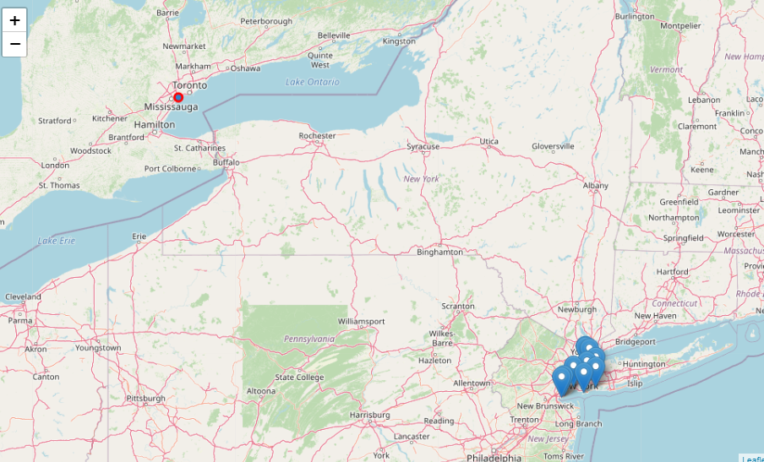
Result
Here one decides to move from Etobicoke, 'Alderwood, Long Branch', Toronto so in the map, it pinned the neighborhood in Newyork which almost has similar features

Slide 8
Discussion
There are 304 common venues in between there two cities which help to find the similar neighborhood for a person to move from one city to another city

Slide 9
Thank you

